Slide 1
Team U5 - WarZone (Risk Computer Game)
SOEN-6441: Advanced Programming Practices
Build 2
Team Members:
Abhishek Handa
Rajat Sharma
Harman Singh Jolly
Amanpreet Singh
Anurag Teckchandani
(40231719)
(40196467)
(40204947)
(40221947)
(40263724)

Slide 2
Naming Conventions
Data members, Member functions and Method Parameters
All are in lower camelCase like int thisIsExampleFunction (int p1, int p2)
And data members like int d_gameEngine
Classes
Class names are in upper CamelCase like
GameEngine.java and OrderExecutionPhase.java
Local Variables
They follow lower camelCase along with "I_." stating it is a local variable like
L_reader, l_continue
Static Members/Constants
All static members are in UPPER_SNAKE_CASE letters with underscores in between the words like int EXAMPLE_VALUE = alpha;

Slide 3
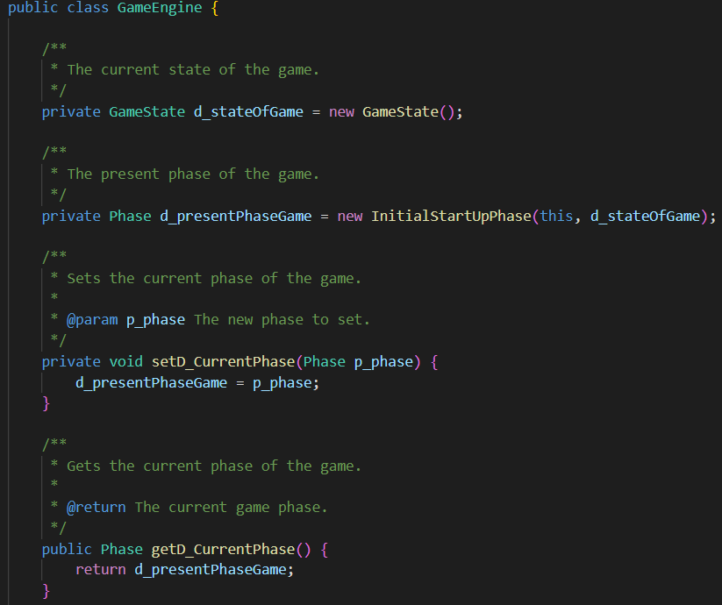
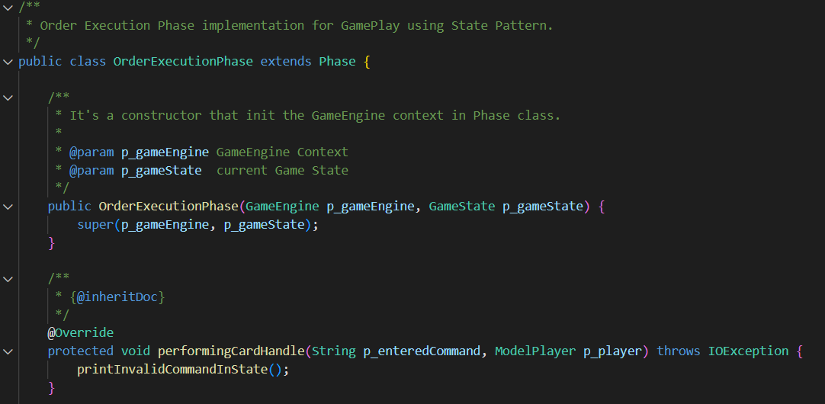
Example of Naming Conventions Used (Snapshots)

Slide 4
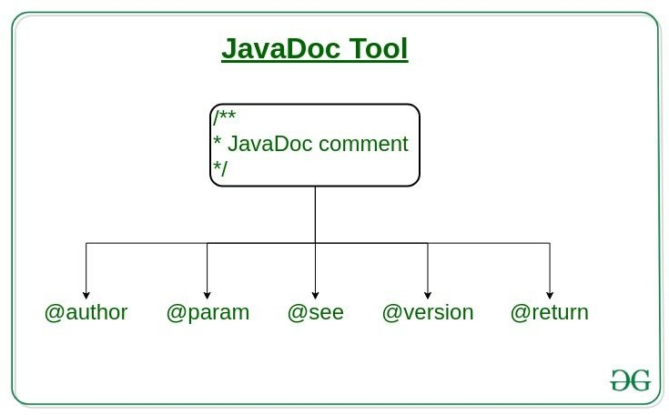
Javadocs
JavaDoc tool is a document generator tool in Java programming language for generating standard documentation in HTML format. It generates API documentation. It parses the declarations ad documentation in a set of source file describing classes, methods, constructors, and fields.
From GeeksForGeeks

Slide 5
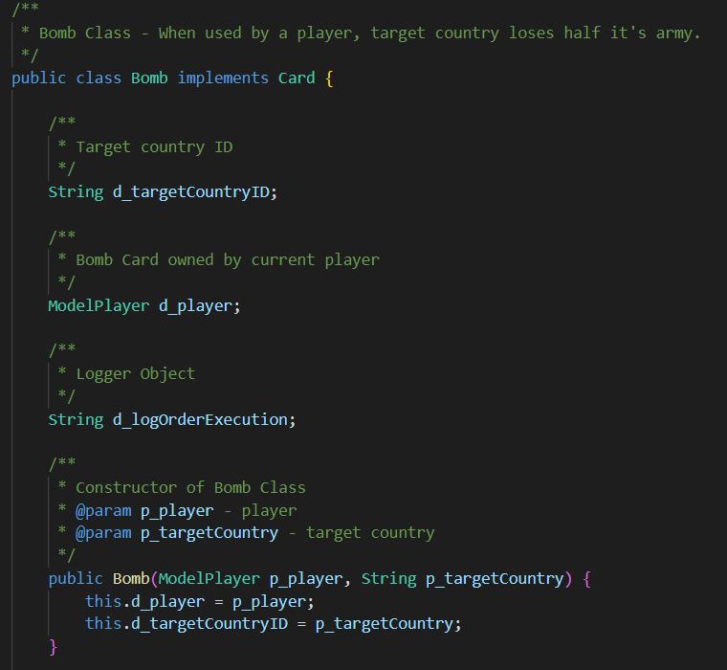
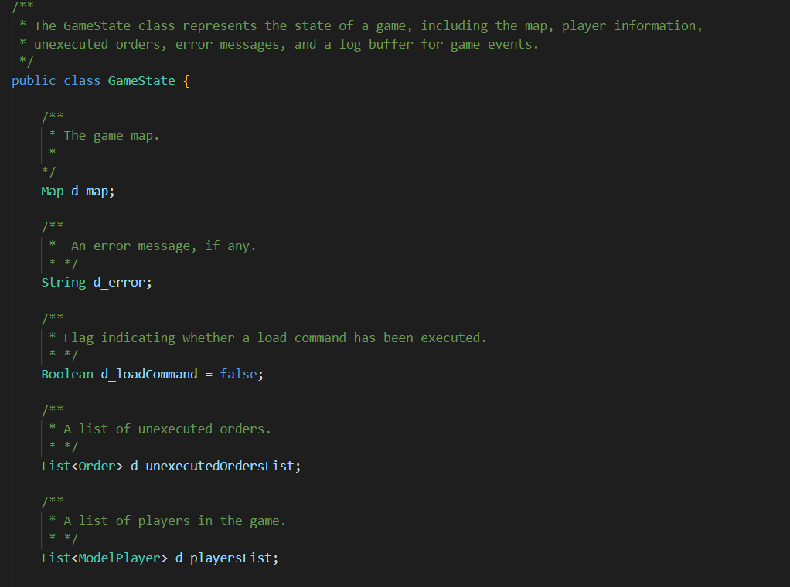
Example of Javadocs Used (Snapshots)

Slide 6
Architectural Design – State Pattern
Context: This represents the object whose behavior is state-dependent. It holds a reference to a ConcreteState object that defines the current state of the Context. Some of its methods leverage the state-specific behavior of the State object to offer context-specific functionality. A change in the state object results in a change in the behavior of the Context object.
State: This class defines the operations that each state must handle. It is typically implemented as an abstract class or interface.
ConcreteState: These classes implement the state-specific behavior.

Slide 7
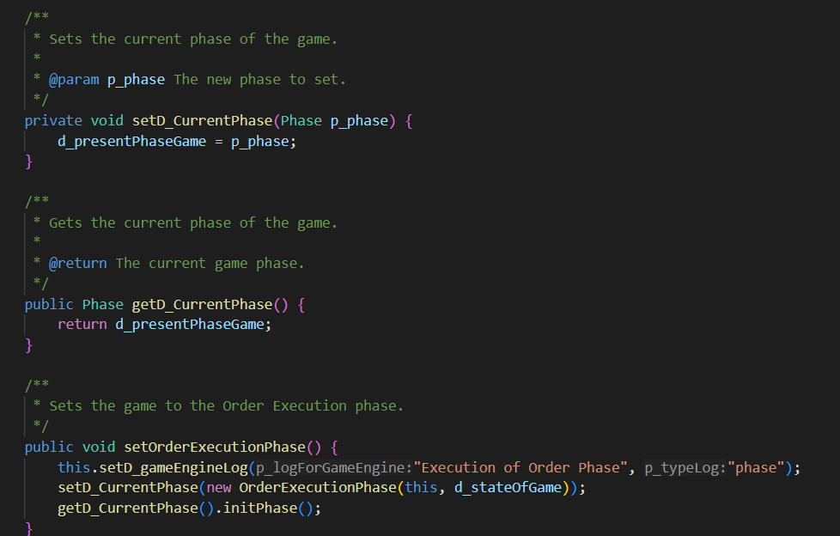
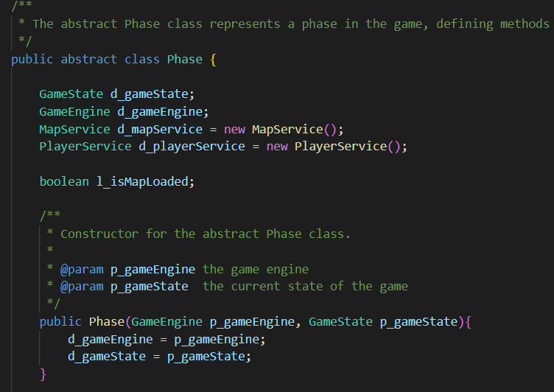
Architectural Design – State Pattern (Example)

Slide 8
Architectural Design – Observer Pattern
The elements of observer pattern are as follows:
Subject - interface or abstract class defining the operations for attaching and de-attaching observers to the client. It is often referred to as “Observable”.
ConcreteSubject - concrete Subject class. It maintains the state of the observed object and when a change in its state occurs it notifies the attached Observers. If used as part of MVC, the ConcreteSubject classes are the Model classes that have Views attached to them.

Slide 9
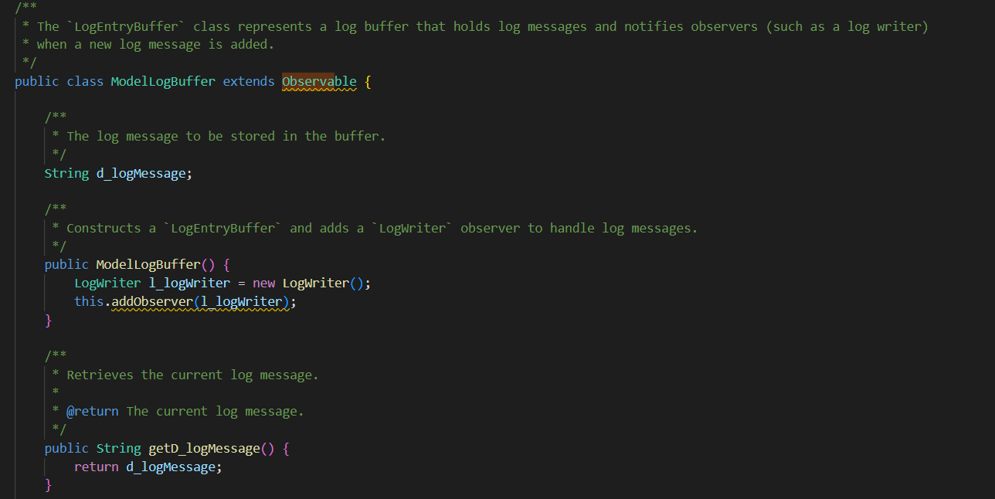
Architectural Design – Observer Pattern (Example)

Slide 10
Architectural Design – Command Pattern
The Command pattern comprises the following components:
Invoker: This is an entity responsible for generating the command object required to execute a specific operation.
Receiver: It's an entity that will be impacted or utilized when the command is executed.
Command: This class defines the operations that each command must address. It's commonly realized as an abstract class or interface.
ConcreteCommand: This object holds the context required for operation execution and contains the code that performs the actual operation.

Slide 11
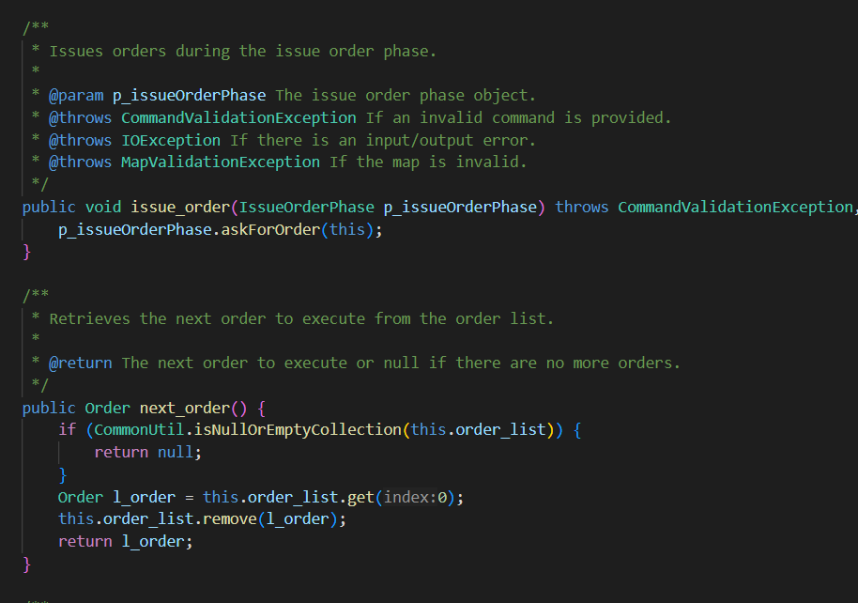
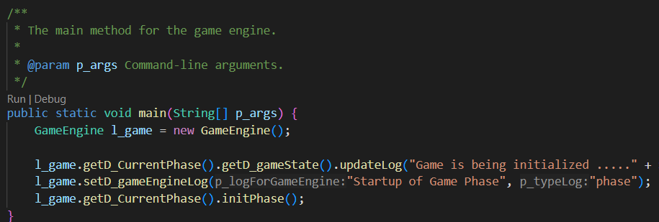
Architectural Design – Command Pattern (Example)

Slide 12
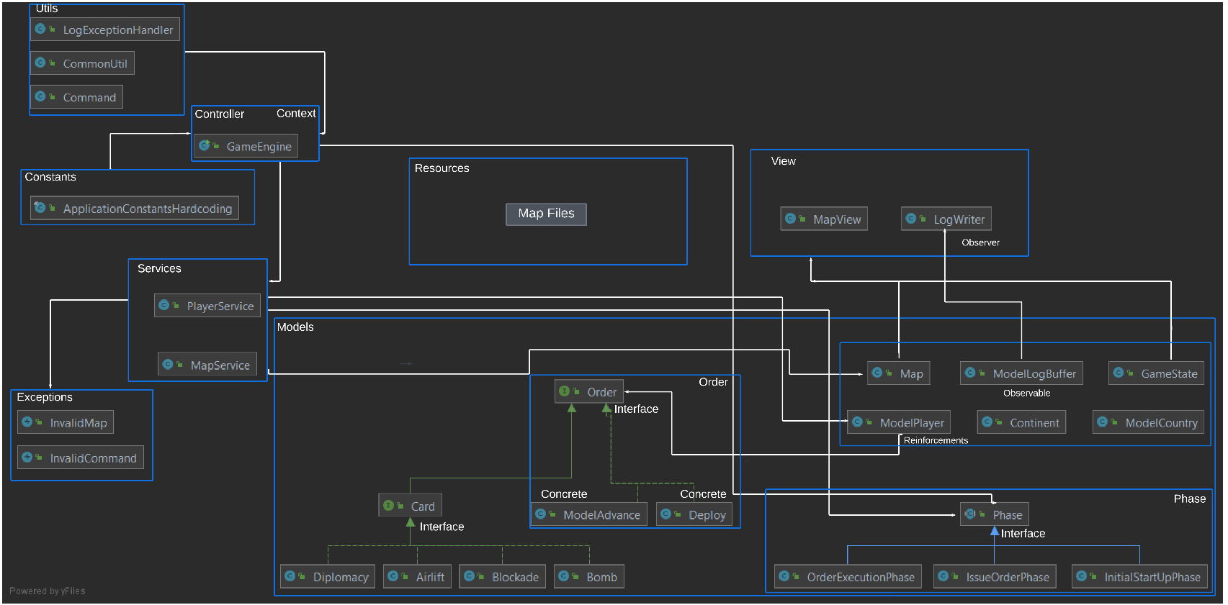
Our Design

